Slide 1
Chapter 1 The Nature of Science

Slide 2
Section 1.1 – Earth Science
Objectives
Differentiate among the four branches of Earth Science
Contrast the four systems of Earth
Discuss how Earth Science affects your daily life

Slide 3
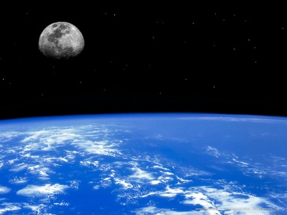
The Scope of Earth Science
The field of Earth Science can be broken into four major areas of specialization:
Astronomy
Meteorology
Geology
Oceanography
1. Astronomy is the study of objects beyond Earth’s atmosphere
- Astronomers study the universe and everything in it, including Earth, its neighbors, and other bodies in the universe.

Slide 4
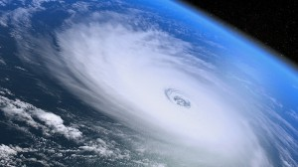
The Scope of Earth Science
2. Meteorology is the branch of Earth Science that studies the air that surrounds our planet.
- Meteorologist study the forces and processes that cause the atmosphere to change to produce weather.
- They also try to predict the weather and how changes in weather might affect Earth’s climate.

Slide 5
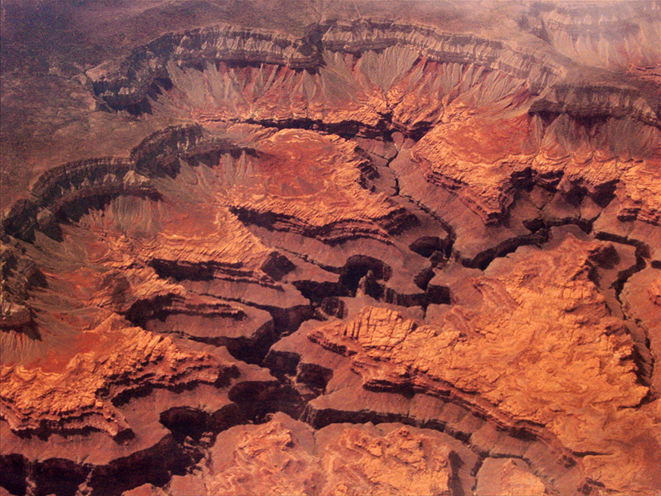
The Scope of Earth Science
3. Geology is the study of the materials that make up Earth and the processes that form and change these materials.
- Geologists identify rocks, study glacial
movements, interpret clues to Earth’s
4.6 billion year history, and determine how forces change our planet, among many other things.

Slide 6
The Scope of Earth Science
4. Oceanography is the study of Earth’s oceans, which cover nearly three-fourths of the planet.
Oceanographers study the creatures that inhabit salty water, measure different physical properties of the oceans, and observe various processes in these bodies of water.

Slide 7
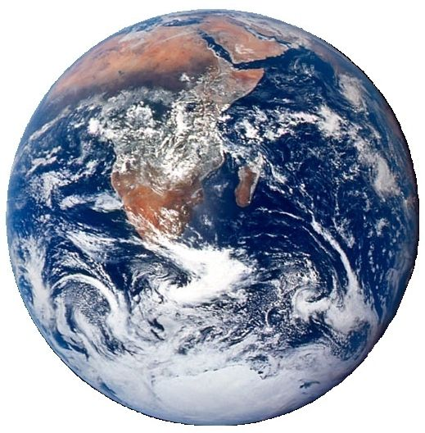
The Scope of Earth Science
The study of our planet is a broad endeavor, and thus it requires a variety of subspecialties of the four major areas of Earth Science.

Slide 8
The Scope of Earth Science
Table 1.1 – Some Subspecialties of Earth Science
Climate | Patterns of weather over a long period of time; effects of human activities on weather and climate
Paleontology | Remains of organisms that once lived on Earth; ancient environments
Hydrology | Water flow on and below Earth’s surface; sources of and solutions to water pollution

Slide 9
The Scope of Earth Science
Table 1.1 – Some Subspecialties of Earth Science
Ecology | Habitats of organisms and how organisms interact with each other and their environments
Geochemistry | Earth’s composition and the processes that change it
Tectonics | Effects of internal processes on Earth’s surface, including earthquakes and mountain building

Slide 10
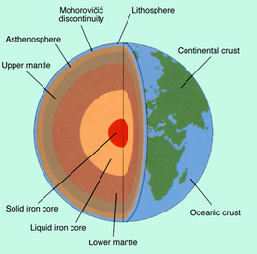
Earth Systems
Scientists who study Earth have identified four main Earth systems: the lithosphere, the hydrosphere, the atmosphere, and the biosphere.
1. The Lithosphere
- Earth’s lithosphere is the rigid outer shell of the planet and includes the crust and the solid, uppermost part of the layer below the crust, the mantle.
- There are two kinds of crust: continental
crust, made mostly of granite, and oceanic
crust which is primarily basalt.

Slide 11
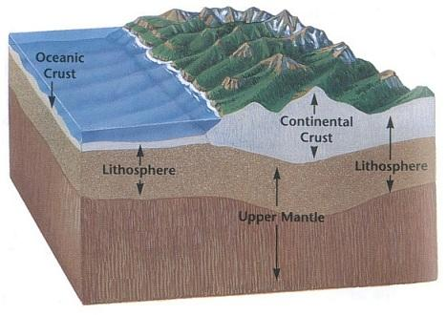
Earth’s Systems
1. The Lithosphere
- Some of Earth’s upper mantle behaves like a rigid solid while other parts of this layer are partially molten and flow like a soft plastic. This partially molten layer of the mantle is the asthenosphere.
- Beneath Earth’s mantle is the core, which can be divided into two parts: an outer, liquid part and a solid, inner part.
- Earth’s core and asthenosphere
are not parts of the lithosphere but
they interact with it.

Slide 12
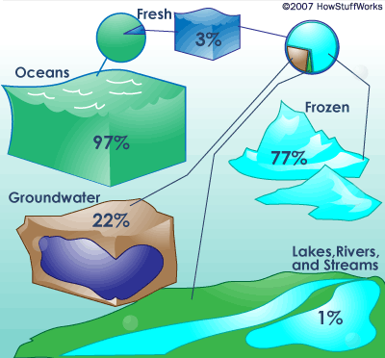
Earth’s Systems
2. The Hydrosphere
- The hydrosphere consists of the water in Earth’s oceans, seas, lakes, rivers and glaciers, as well as the water in the atmosphere.
About 97% of Earth’s water exists as salt water; the remaining 3% is freshwater contained in glaciers, in lakes and rivers, and
beneath Earth’s surface as
groundwater.

Slide 13
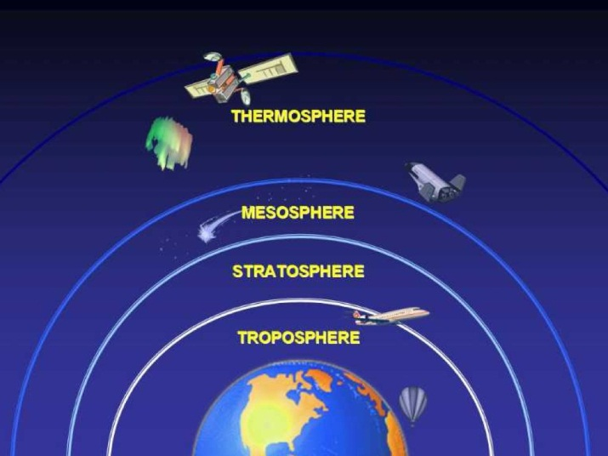
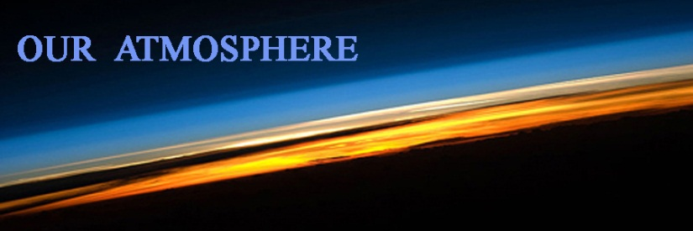
Earth’s Systems
3. The Atmosphere
- The atmosphere is the blanket of gases that surrounds our planet.
- Earth’s atmosphere is necessary for respiration by most living things, protects Earth’s inhabitants from harmful radiation from the Sun, and helps to keep the planet at a temperature suitable for life.

Slide 14
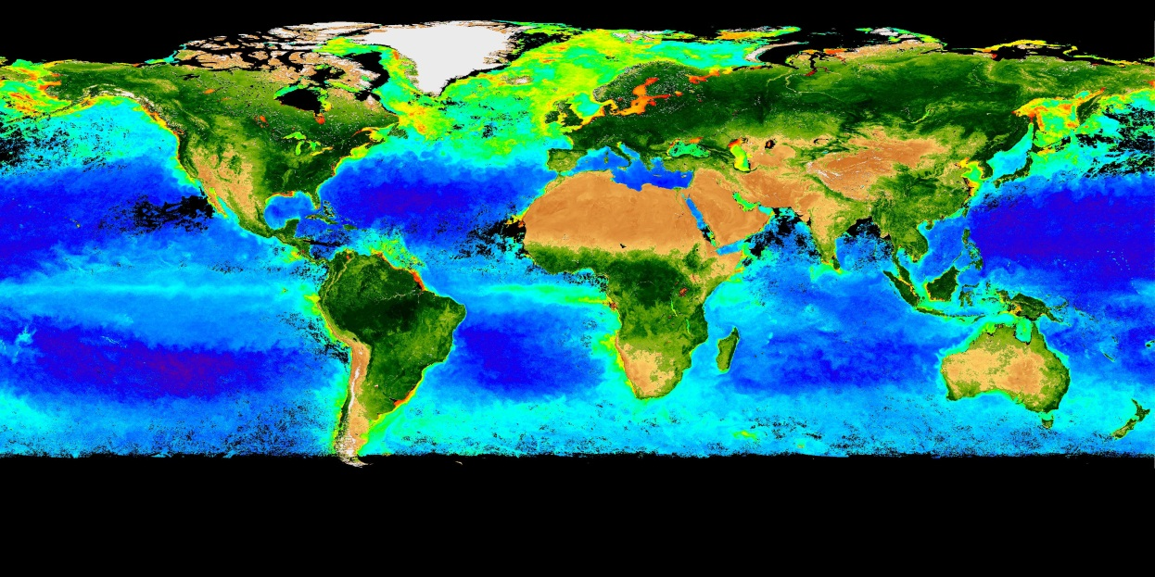
Earth’s Systems
4. The Biosphere
- The biosphere includes all organisms on Earth as well as the environments in which they live.
- With some exceptions, most organisms exist within a few meters of Earth’s surface.

Slide 15
Earth Science in Your Everyday Life
You and the billions of other life-forms that live on Earth are part of the biosphere.
Technology
- The study of science, including Earth Science, has led to the discovery of many things that you use every day.
- This application of scientific discoveries is called technology.
- Technology is transferable, which means that it can be applied to new situations.

Slide 16
Objectives for Section 1.2
List the steps used in a scientific method
Compare and contrast experimental variables and controls
Identify basic SI units
Explain how to write numbers using scientific notation

Slide 17
The Nature of Scientific Investigations
A scientific method is a planned, organized approach to solving a problem.
Once the problem is defined and research is complete, a hypothesis, or suggested explanation for an observation, is made.

Slide 18
The Nature of Scientific Investigations
6 Steps of Scientific Method
State Problem
Gather information
Form hypothesis
Test hypothesis
Analyze data
Draw conclusions

Slide 19
The Nature of Scientific Investigation
A hypothesis is tested by conducting an experiment which is an organized procedure that involves making measurements and observation.
A good scientific experiment tests only one variable, or changeable factor, at a time
The independent variable is the factor that is manipulate by the experimenter.
The dependent variable is a factor that can change if the independent variable is changed.
A control is used to show that the results of an experiment are a result of the condition being tested.

Slide 20
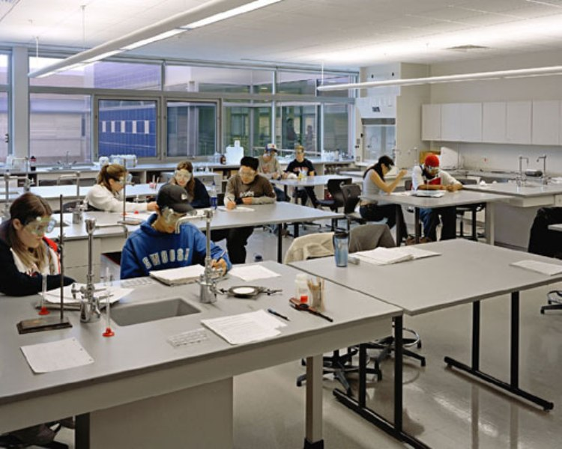
The Nature of Scientific Investigation
Safety in the Science Classroom
When conducting any scientific investigation, it is important to use all materials and equipment only as instructed.
Follow the safety rules listed in Table 1.2 to help prevent injury to you and others in the lab as well as make sure you are aware of possible hazards in a science lab.

Slide 21
The Nature of Scientific Investigations
Analysis and Conclusions
During a scientific experiment, all data, including measurements and observations, are carefully recorded.
Once an experiment is complete, the data must be formatted so that they can be studied, or analyzed.
If a conclusion is contrary to the original hypothesis, the hypothesis may be changed.
Remember, scientific methods
are not rigid, step by step outlines
to solve problems.

Slide 22
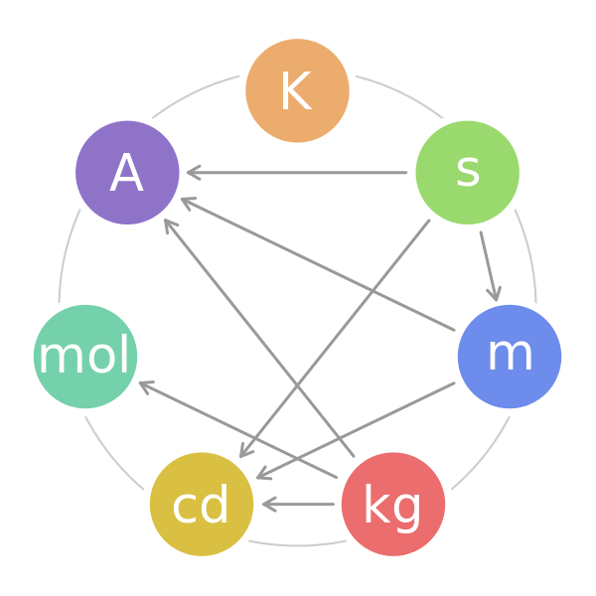
Measurement
Most scientific studies and experiments use a standard system of metric units called Le Systeme International d’Unites or SI for short.
SI is a modern version of the metric system based on a decimal system that uses the number 10 as the base unit.

Slide 23
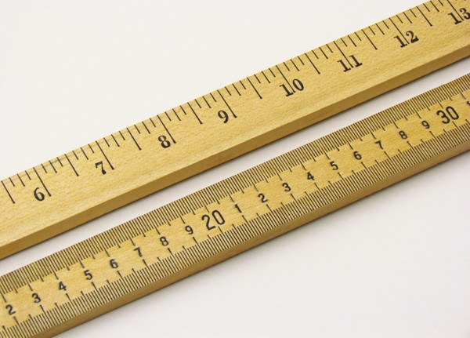
Measurement
The standard SI unit to measure length is the meter.
The meter is divided into 100 equal parts called centimeters.
The centimeter is divided into 10 equal parts called millimeters.
Long distances are measured in kilometers which is 1000 meters.

Slide 24
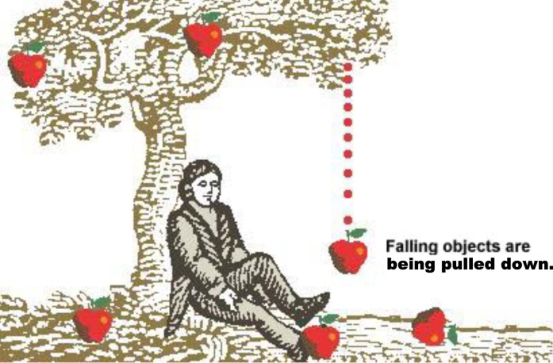
Measurement
Weight and Mass
Weight is a measure of the gravitational force on an object.
Weight varies with location depending on gravitational force.
Weight is a force and the SI unit for the force is the Newton (N).
Mass is the amount of matter in an object.
The mass of an object, unlike weight, does not change with an object’s position.

Slide 25
Measurement
Area and Volume
Area is the amount of surface included within a set of boundaries and is expressed in square units of length, such as square meters (m²).
The amount of space occupied by an object is the object’s volume.
The SI units for volume are derived from the SI units used to measure length.
The basic SI unit of volume for a regularly shaped solid object is the cubic meter (m³).
SI measurements for liquid volumes are usually made in milliLiter (mL) or Liters (L).

Slide 26
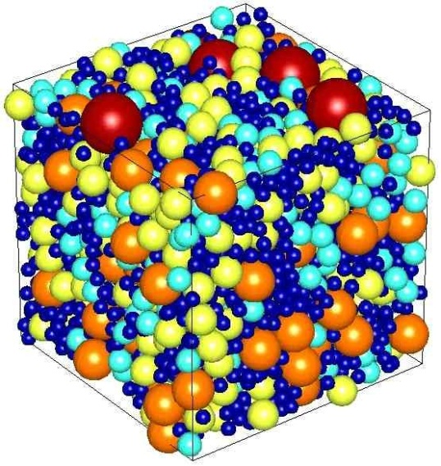
Measurement
Density
Density is a measure of the amount of matter that occupies a given space.
Density is calculated by dividing the mass of the matter by its volume.
Time
Time is the interval between two events and is usually measured with a watch or clock.
The SI unit of time is the second (s).

Slide 27
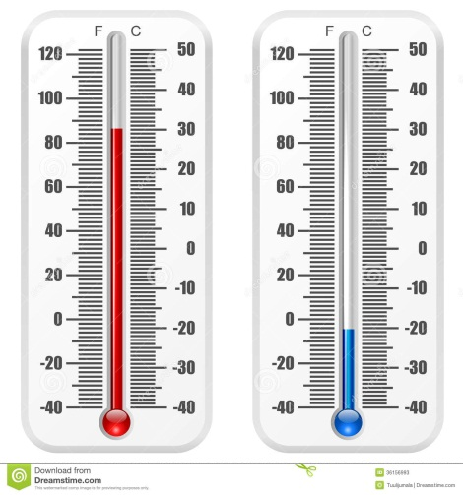
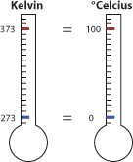
Measurement
Temperature
Temperature is a measure of the average vibrations of the particles that make up a material.
A mass made up of particles that vibrate quickly has a higher temperature that a mass whose particles vibrate more slowly.
Temperature is measured in degrees with a thermometer.
In science, temperature is often measured on the Celsius (C).
In SI, temperature is measured on the Kelvin (K) scale.

Slide 28
Scientific Notation
To express numbers that are very large or small, scientists use a type of shorthand called scientific notation to express the number as a multiplier and a power of 10.
In scientific notation, a number is expressed as a value between 1 and 10 multiplied by a power of 10.
The power of 10 is the number of places the decimal point must be shifted so that only a single digit remains either to the left or right of the decimal point.

Slide 29
Scientific Notation
If the decimal point must be shifted to the left, then exponent of 10 is positive.
If the decimal point in number must be shifted to the right, then the exponent of 10 is negative.
For example:
90,000,000 = 9 x ${10}^{7}$
5,974,200,000 = 5.9742 x${10}^{9}$
0.00000025 = 2.5 x ${10}^{−7}$

