Slide 1
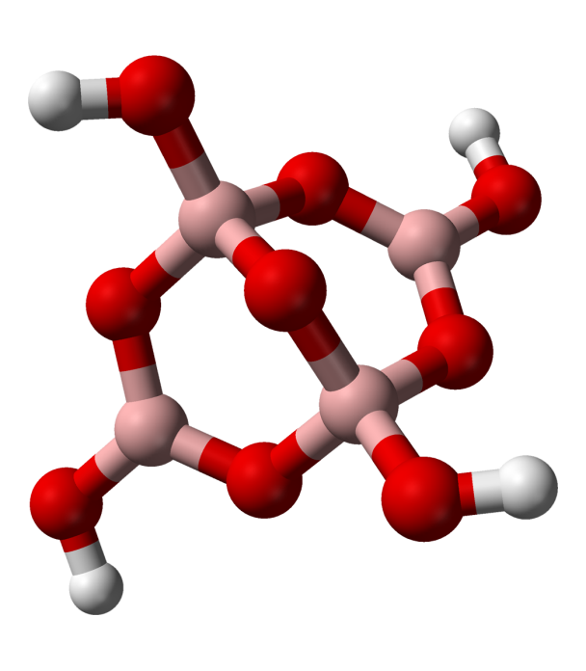
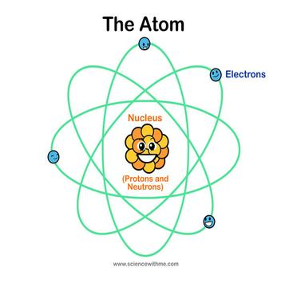
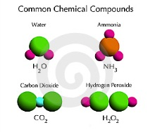
Chemistry Basics
Objectives:
Distinguish between Atoms, Elements and Compounds

Slide 2
Section 3.1 – What are elements?
Elements are made of atoms
An atom is the smallest particle of an element that has all of the characteristics of that element.
All atoms consist of even smaller particles: protons, neutrons and electrons.

Slide 3
Section 3.1 – What are elements?
Elements
An element is a substance that cannot be broken down into simpler substances by physical or chemical means.
92% elements occur naturally on Earth and in the stars.
Other elements have been produced in laboratory experiments.

Slide 4
Section 3.1 – What are elements?
Elements
Each element is identified by a one, two or three letter abbreviation know as a chemical symbol.
Table 3-1 Chemical Symbols of Some Elements
Hydrogen H | Helium He | Lithium Li
Nitrogen N | Boron B | Mercury Hg
Neon Ne | Oxygen O | Carbon C
Aluminum Al | Sodium Na | Calcium Ca
Potassium K | Gold Au | Silicon Si
Silver Ag | Copper Cu | Magnesium Mg

Slide 5
Section 3.1 – What are elements?
What elements are most abundant?
The two most abundant elements in the universe are hydrogen and helium.
Hydrogen – 93.5%
Helium – 6.3%
Oxygen – 0.065%
Others – .14%

Slide 6
Section 3.1 – What are elements?
What elements are the most abundant?
The percentages of elements in Earth’s crust differ from the percentages in the universe.
Earth’s crust – main components
Oxygen – 46.6%
Silicon – 27.7%
Aluminum – 8.1%
Iron – 5.0%

Slide 7
Section 4.1 – Minerals from Solution

Slide 8
Section 3.2 – Compounds
A compound is a substance that is composed of atoms of two or more different elements that are chemically combined.
Most compounds have totally different properties from the elements of which they are composed.
Examples: NaCl – Sodium Chloride (Salt)

Slide 9
Section 4.1 – Minerals from Solution
What is a mineral?
Earth’s crust is composed of about 3000 minerals.
Minerals play important roles in forming rocks and in shaping Earth’s surface, and a select few have played a role in shaping civilization.

Slide 10
Section 4.1 – Minerals from Solution
Mineral Characteristics
A mineral must have all 5 characteristics:
Naturally occurring
Inorganic
A solid
Specific chemical composition
Definite crystalline structure

Slide 11
Section 4.1 – Minerals from Solution
Minerals from Magma
Minerals can form from the cooling of magma.
Magma is molten material found beneath Earth’s surface.
Small crystals form from rapidly cooling magma and large crystals form from slowly cooling magna.

Slide 12
Section 4.1 – Minerals from Solution
A given volume of water in a solution can dissolve only so much of a solid before the water becomes saturated.
If a solution become supersaturated, or overfilled, with another substance, mineral crystals may begin to precipitate, or drop out of solution.
When liquid evaporates from a supersaturated solution, the elements remain behind and may begin to arrange into crystals.

Slide 13
Section 4.1 – Minerals from Solution
About 30 minerals are common in Earth’s crust.
The most common minerals are often referred to as rock-forming minerals because they make up most of the rocks found in Earth’s crust.
The vast majority of minerals are made up of the eight most common elements.

Slide 14
Section 4.2 – Mineral Identification
Geologists rely on several relatively simple tests to identify minerals.
These tests are based upon a mineral’s physical and chemical properties.
It is usually best to use a combination of tests rather than just one to identify minerals.

Slide 15
Section 4.2 – Mineral Identification
Color
One of the most noticeable characteristics of a mineral is its color.
Color is sometimes caused by the presence of trace elements or compounds within a mineral.
In general, color is one of the least reliable clues to a mineral’s identity.

Slide 16
Section 4.2 – Mineral Identification
Luster
Luster is the way that a mineral reflects light from its surface
Luster is described as being either metallic or nonmetallic
Metallic luster describes shiny surfaces that reflect light like the chrome trim on cars
Nonmetallic luster might be described as dull, pearly, waxy or silky

Slide 17
Section 4.2 – Mineral Identification
Texture
Texture describes how a mineral feels to the touch.
The texture of a mineral might be described as smooth, rough, ragged, greasy, soapy, or glassy.

Slide 18
Section 4.2 – Mineral Identification
Streak
Streak is the color of a mineral when it is broken up and powdered.
Sometimes, a mineral’s streak does not match the mineral’s external color.
A mineral’s streak rarely changes, even if it is weathered or its external color varies slightly. This is a good way to identify the mineral.
A streak plate is used to test the streak.

Slide 19
Section 4.2 – Mineral Identification
Hardness
Hardness is one of the most useful and reliable test for identifying minerals.
Hardness is a measure of how easily a mineral can be scratched.
German geologist Friedrich Mohs developed a scale in which an unknown mineral’s hardness can be compared to the know hardness of ten minerals.

Slide 20
Section 4.2 – Mineral Identification
Hardness
Any mineral with a greater hardness than another mineral can scratch that softer mineral.
1-10 scale: 1 = soft, crumbles; 10 = Diamond, nothing can scratch it

Slide 21
Section 4.2 – Mineral Identification
Hardness
Hardness of Mineral |  | Hardness of Common Objects
Talc | 1
Gypsum | 2 | Fingernail (2.5)
Calcite | 3 | Piece of copper (3.5)
Fluorite | 4 | Iron nail (4.5)
Apatite | 5 | Glass (5.5)
Feldspar | 6 | Steel file (6.5)
Quartz | 7 | Streak plate (7)
Topaz | 8 | Scratches Quartz
Corundum | 9 | Scratches Topaz
Diamond | 10 | Scratches all common materials

Slide 22
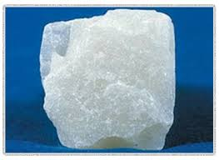
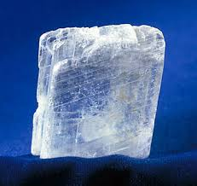
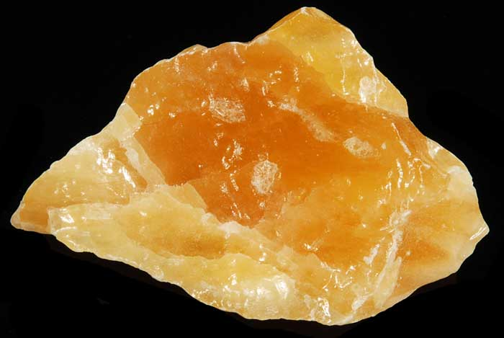
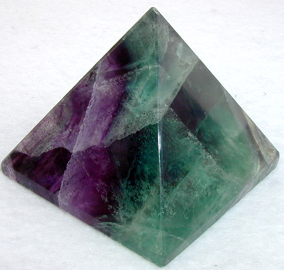
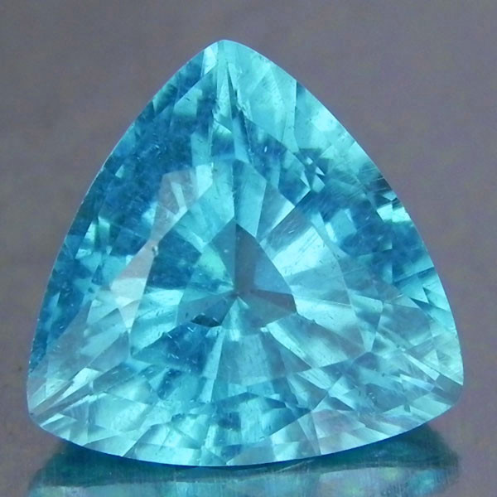
Talc
Gypsum
Calcite
Fluorite
Apatite

Slide 23
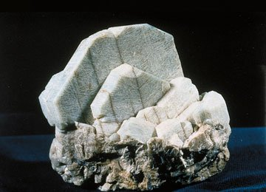
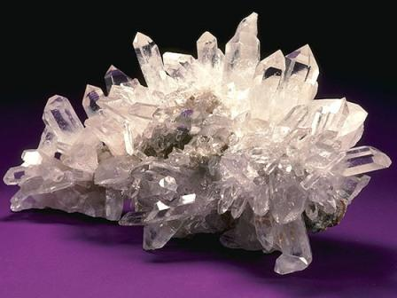
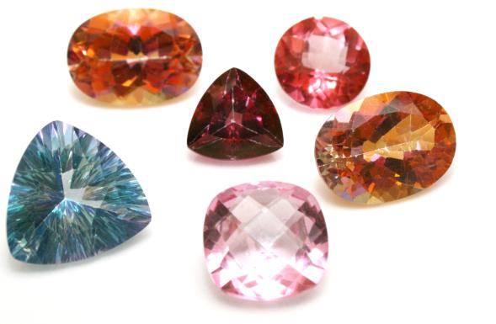
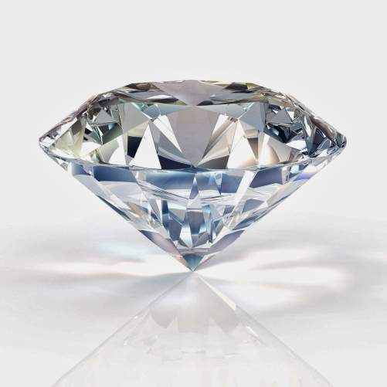
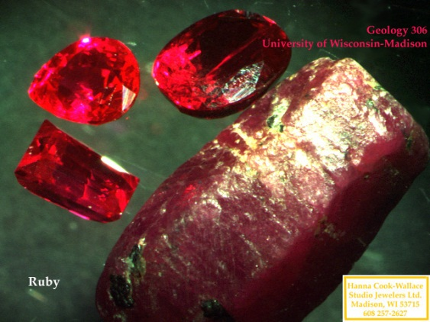
Feldspar
Quartz
Topaz
Corundum
Diamond

Slide 24
Section 4.2 – Mineral Identification
Cleavage
Minerals break along planes where atomic bonding is weak.
Cleavage is the ability of a mineral to split relatively easily and evenly alone one or more flat planes.
To identify a mineral by cleavage, geologists count the number of cleaved planes and study the angle or angles between them.

Slide 25
Section 4.2 – Mineral Identification
Fracture
Fracture is the ability of minerals to break with arclike, rough, or jagged edges.

Slide 26
Section 4.2 – Mineral Identification
Special Properties
Special properties of minerals also can be used for identification purposes.
A type of calcite called Iceland spar causes light to be bent in two directions, a process know as double refraction, when it passes through the mineral.
Calcite (CaCo₃) fizzes when it comes into contact with hydrochloric acid (HCl), causing a chemical reaction.
Magnetite, an iron ore, is naturally magnetic.
Fluorescence: some minerals fluoresce under a UV lamp.

Slide 27
Section 4.2 – Mineral Identification
Mineral Uses
Minerals are virtually everywhere.
They are used to make computers, cars, televisions, desks, roads, building, jewelry, beds, paints, sports equipment, and medicines, just to name a few uses.

Slide 28
Section 4.2 – Mineral Identification
Mineral Uses
Ore
An ore is a mineral that contains a useful substance that can be mined at a profit.
Examples of ores include Hematite, which contains the element iron, and Bauxite, which contains the element aluminum.

Slide 29
Section 4.2 – Mineral Identification
Mineral Uses
Mines
Ores are removed by underground mining or from large, open-pit mines.
When a mine is excavated, unwanted rock and dirt, known as waste material, are dug up along with ore.
If the cost of separating the waste material becomes higher than the value of the ore itself, then the mineral will no longer be classified as an ore because it would no longer be economical to mine it.
The classification of a mineral as an ore may also change if the supply of or demand for that mineral changes.

Slide 30
Section 4.2 – Mineral Identification
Gems
Gems are valuable minerals that are prized for their rarity and beauty.
Gems such as rubies, emeralds and diamonds are cut, polished, and used for jewelry.
In some cases, the presence of trace elements can make one variety of a mineral more colorful and thus more prized than other varieties of the same mineral.

