Slide 1
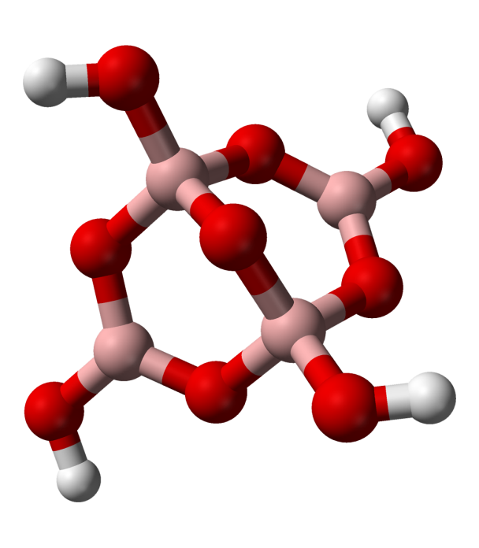
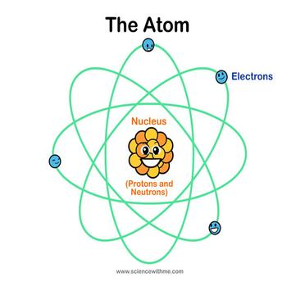
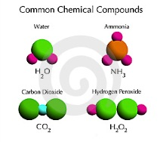
Chemistry Basics
Objectives:
Distinguish between Atoms, Elements and Compounds

Slide 2
Section 3.1 – What are elements?
Elements are made of atoms
An atom is the smallest particle of an element that has all of the characteristics of that element.
All atoms consist of even smaller particles: protons, neutrons and electrons.

Slide 3
Section 3.1 – What are elements?
Elements
An element is a substance that cannot be broken down into simpler substances by physical or chemical means.
92% elements occur naturally on Earth and in the stars.
Other elements have been produced in laboratory experiments.

Slide 4
Section 3.1 – What are elements?
Elements
Each element is identified by a one, two or three letter abbreviation know as a chemical symbol.
Table 3-1 Chemical Symbols of Some Elements
Hydrogen H | Helium He | Lithium Li
Nitrogen N | Boron B | Mercury Hg
Neon Ne | Oxygen O | Carbon C
Aluminum Al | Sodium Na | Calcium Ca
Potassium K | Gold Au | Silicon Si
Silver Ag | Copper Cu | Magnesium Mg

Slide 5
Section 3.1 – What are elements?
What elements are most abundant?
The two most abundant elements in the universe are hydrogen and helium.
Hydrogen – 93.5%
Helium – 6.3%
Oxygen – 0.065%
Others – .14%

Slide 6
Section 3.1 – What are elements?
What elements are the most abundant?
The percentages of elements in Earth’s crust differ from the percentages in the universe.
Earth’s crust – main components
Oxygen – 46.6%
Silicon – 27.7%
Aluminum – 8.1%
Iron – 5.0%

Slide 7
Section 4.1 – Minerals from Solution

Slide 8
Section 3.2 – Compounds
A compound is a substance that is composed of atoms of two or more different elements that are chemically combined.
Most compounds have totally different properties from the elements of which they are composed.
Examples: NaCl – Sodium Chloride (Salt)

Slide 9
Section 4.1 – Minerals from Solution
What is a mineral?
Earth’s crust is composed of about 3000 minerals.
Minerals play important roles in forming rocks and in shaping Earth’s surface, and a select few have played a role in shaping civilization.

Slide 10
Section 4.1 – Minerals from Solution
Mineral Characteristics
A mineral must have all 5 characteristics:
Naturally occurring
Inorganic
A solid
Specific chemical composition
Definite crystalline structure

Slide 11
Section 4.1 – Minerals from Solution
Minerals from Magma
Minerals can form from the cooling of magma.
Magma is molten material found beneath Earth’s surface.
Small crystals form from rapidly cooling magma and large crystals form from slowly cooling magna.

Slide 12
Section 4.1 – Minerals from Solution
A given volume of water in a solution can dissolve only so much of a solid before the water becomes saturated.
If a solution become supersaturated, or overfilled, with another substance, mineral crystals may begin to precipitate, or drop out of solution.
When liquid evaporates from a supersaturated solution, the elements remain behind and may begin to arrange into crystals.

Slide 13
Section 4.1 – Minerals from Solution
About 30 minerals are common in Earth’s crust.
The most common minerals are often referred to as rock-forming minerals because they make up most of the rocks found in Earth’s crust.
The vast majority of minerals are made up of the eight most common elements.

Slide 14
Section 4.2 – Mineral Identification
Geologists rely on several relatively simple tests to identify minerals.
These tests are based upon a mineral’s physical and chemical properties.
It is usually best to use a combination of tests rather than just one to identify minerals.

Slide 15
Section 4.2 – Mineral Identification
Color
One of the most noticeable characteristics of a mineral is its color.
Color is sometimes caused by the presence of trace elements or compounds within a mineral.
In general, color is one of the least reliable clues to a mineral’s identity.

Slide 16
Section 4.2 – Mineral Identification
Luster
Luster is the way that a mineral reflects light from its surface
Luster is described as being either metallic or nonmetallic
Metallic luster describes shiny surfaces that reflect light like the chrome trim on cars
Nonmetallic luster might be described as dull, pearly, waxy or silky

Slide 17
Section 4.2 – Mineral Identification
Texture
Texture describes how a mineral feels to the touch.
The texture of a mineral might be described as smooth, rough, ragged, greasy, soapy, or glassy.

Slide 18
Section 4.2 – Mineral Identification
Streak
Streak is the color of a mineral when it is broken up and powdered.
Sometimes, a mineral’s streak does not match the mineral’s external color.
A mineral’s streak rarely changes, even if it is weathered or its external color varies slightly. This is a good way to identify the mineral.
A streak plate is used to test the streak.

Slide 19
Section 4.2 – Mineral Identification
Hardness
Hardness is one of the most useful and reliable test for identifying minerals.
Hardness is a measure of how easily a mineral can be scratched.
German geologist Friedrich Mohs developed a scale in which an unknown mineral’s hardness can be compared to the know hardness of ten minerals.

Slide 20
Section 4.2 – Mineral Identification
Hardness
Any mineral with a greater hardness than another mineral can scratch that softer mineral.
1-10 scale: 1 = soft, crumbles; 10 = Diamond, nothing can scratch it

Slide 21
Section 4.2 – Mineral Identification
Hardness
Hardness of Mineral |  | Hardness of Common Objects
Talc | 1
Gypsum | 2 | Fingernail (2.5)
Calcite | 3 | Piece of copper (3.5)
Fluorite | 4 | Iron nail (4.5)
Apatite | 5 | Glass (5.5)
Feldspar | 6 | Steel file (6.5)
Quartz | 7 | Streak plate (7)
Topaz | 8 | Scratches Quartz
Corundum | 9 | Scratches Topaz
Diamond | 10 | Scratches all common materials

Slide 22
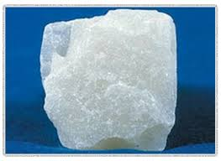
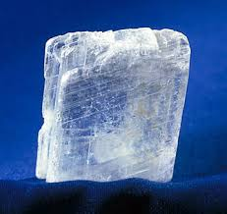
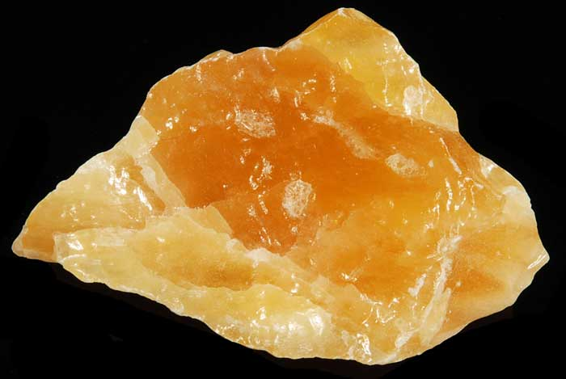
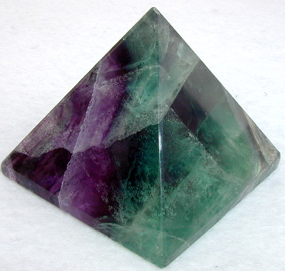
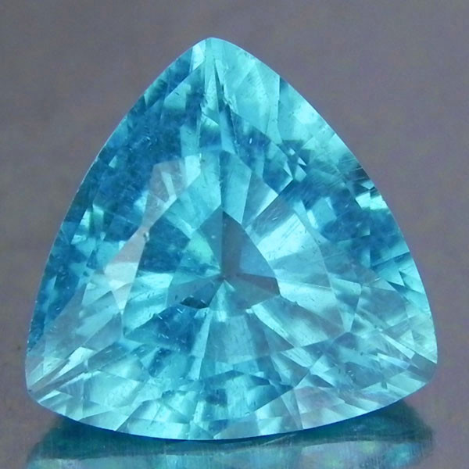
Talc
Gypsum
Calcite
Fluorite
Apatite

Slide 23
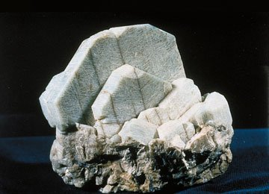
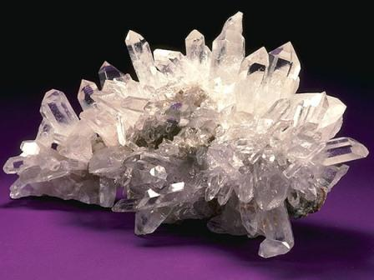
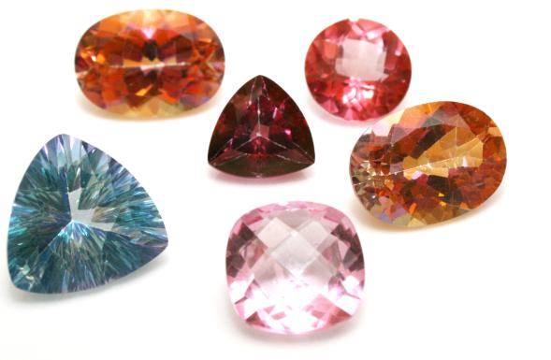
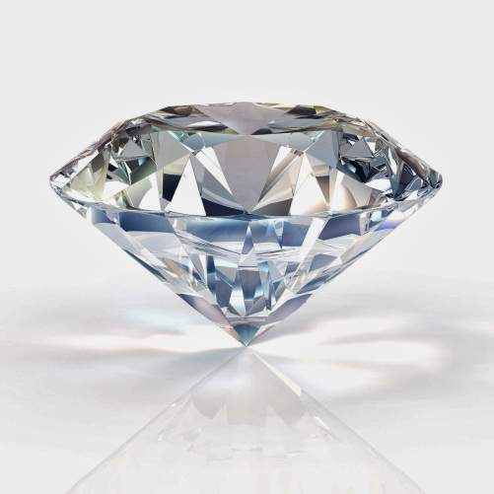
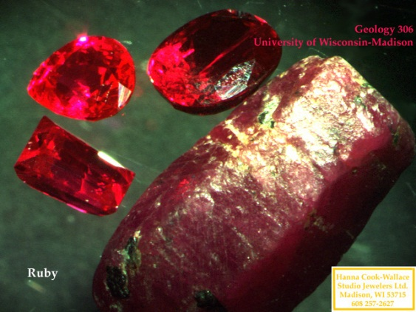
Feldspar
Quartz
Topaz
Corundum
Diamond

Slide 24
Section 4.2 – Mineral Identification
Cleavage
Minerals break along planes where atomic bonding is weak.
Cleavage is the ability of a mineral to split relatively easily and evenly along one or more flat planes.
To identify a mineral by cleavage, geologists count the number of cleaved planes and study the angle or angles between them.

Slide 25
Section 4.2 – Mineral Identification
Fracture
Fracture is the ability of minerals to break with arclike, rough, or jagged edges.

Slide 26
Section 4.2 – Mineral Identification
Special Properties
Special properties of minerals also can be used for identification purposes.
A type of calcite called Iceland spar causes light to be bent in two directions, a process know as double refraction, when it passes through the mineral.
Calcite (CaCo₃) fizzes when it comes into contact with hydrochloric acid (HCl), causing a chemical reaction.
Magnetite, an iron ore, is naturally magnetic.
Fluorescence: some minerals fluoresce under a UV lamp.

Slide 27
Section 4.2 – Mineral Identification
Mineral Uses
Minerals are virtually everywhere.
They are used to make computers, cars, televisions, desks, roads, building, jewelry, beds, paints, sports equipment, and medicines, just to name a few uses.

Slide 28
Section 4.2 – Mineral Identification
Mineral Uses
Ore
An ore is a mineral that contains a useful substance that can be mined at a profit.
Examples of ores include Hematite, which contains the element iron, and Bauxite, which contains the element aluminum.

Slide 29
Section 4.2 – Mineral Identification
Mineral Uses
Mines
Ores are removed by underground mining or from large, open-pit mines.
When a mine is excavated, unwanted rock and dirt, known as waste material, are dug up along with ore.
If the cost of separating the waste material becomes higher than the value of the ore itself, then the mineral will no longer be classified as an ore because it would no longer be economical to mine it.
The classification of a mineral as an ore may also change if the supply of or demand for that mineral changes.

Slide 30
Section 4.2 – Mineral Identification
Gems
Gems are valuable minerals that are prized for their rarity and beauty.
Gems such as rubies, emeralds and diamonds are cut, polished, and used for jewelry.
In some cases, the presence of trace elements can make one variety of a mineral more colorful and thus more prized than other varieties of the same mineral.

Slide 31
Section 5.1 – What are Igneous Rocks
What is igneous rock?
Igneous rocks are rocks that are formed from the crystallization of magma
Lava is magma that flows out onto Earth’s surface

Slide 32
Section 5.1 – What are Igneous Rocks
Types of Igneous Rocks
Extrusive igneous rocks are fine-grained igneous rocks that cool quickly on Earth’s surface.
Intrusive igneous rocks are course-grained igneous rocks that cool slowly beneath Earth’s surface
Granite is the most common intrusive igneous rock (made up of the minerals quartz and pink feldspar).

Slide 33
Section 5.1 – What are Igneous Rocks
Types of Igneous Rocks
Careful study of granite rock formations revealed that they cut across other rock formations.
These cross-cutting relationships are evidence that the granite was intruded, or forced into, existing rocks.

Slide 34
Section 5.2 – Classifying Igneous Rocks
Classifying Igneous Rocks
Igneous rocks are broadly classified as intrusive or extrusive.
Igneous rocks are further classified by their mineral compositions.
Physical properties such as grain size and texture serve as clues for the identification of various igneous rocks.

Slide 35
Section 5.2 – Classifying Igneous Rocks
Grain Size
In addition to differences in their mineral compositions, igneous rocks differ in the sizes of their grains.
Cooling rates
When lava flows on Earth’s surface, it cools quickly and there is not enough time for crystals to form.
Extrusive igneous rocks have no visible mineral grains.
When magma cools slowly beneath Earth’s surface, there is sufficient time for large crystals to form.
Intrusive igneous rocks may have crystals larger than 1 cm.

Slide 36
Section 5.2 – Classifying Igneous Rocks
Texture
Porphyritic Texture
A rock that has a porphyritic texture is characterized by large, well-formed crystals surrounded by finer-grained crystals of the same mineral or different minerals.
Porphyritic textures indicate a complex cooling history wherein a slowly cooling magma suddenly began cooling rapidly.

Slide 37
Section 5.2 – Classifying Igneous Rocks
Igneous Rocks as Resources
Igneous rocks have several characteristics that make them especially useful as building materials.
The interlocking grain textures of igneous rocks help to give them strength.
Many of the minerals found in igneous rocks are resistant to weathering.

Slide 38
Section 6.1 – Formation of Sedimentary Rocks
Formation of Sedimentary Rocks
Much of Earth’s surface is covered with sediments.
Sediments are pieces of solid material that have been deposited on Earth’s surface by wind, water, ice, gravity, or chemical precipitation.
When sediments became cemented together, they form sedimentary rocks.
The formations of sedimentary rocks begins when weathering and erosion produce sediments.

Slide 39
Section 6.1 – Formation of Sedimentary Rocks
Weathering
Where Earth’s crust is exposed at the surface, it is subject to weathering.
Weathering is a set of physical and chemical processes that break rock into smaller pieces.
Chemical weathering occurs when the minerals in a rock are dissolved or otherwise chemically changed.
Minerals remain chemically unchanged during physical weathering.

Slide 40
Section 6.1 – Formation of Sedimentary Rocks
Weathering
Clastic describes rock and mineral fragments produced by weathering and erosion.
Clastic sediments range in size from huge boulders to microscopic particles.
Classification of Clastic Sediments
Particle Size | Sediment | Rock
>256 mm | Boulder | Conglomerate
256 – 64 mm | Cobble | Conglomerate
64 – 2 mm | Pebble | Conglomerate
2 – 0.062 mm | Sand | Sandstone
0.062 – 0.0039 mm | Silt | Siltstone
< 0.0039 mm | Clay | Mudstone or Shale

Slide 41
Section 6.1 – Formation of Sedimentary Rocks
Erosion and Transport
After rock fragments have been weathered out of outcrops, they are transported to new locations.
Erosion is the removal and movement of surface materials from one location to another.
The four main agents of erosion are wind, moving water, gravity and glaciers.
Eroded materials are almost always carried downhill.

Slide 42
Section 6.1 – Formation of Sedimentary Rocks
Erosion and Transport
Deposition
Deposition occurs when sediments are laid down on the ground or sink to the bottoms of bodies of water.
Sediments are deposited when transport stop.
As water or wind slows down, the largest particles settle out first, then the next largest, and so on, so that different-sized particles are sorted into layers.

Slide 43
Section 6.1 – Formation of Sedimentary Rocks
Lithification
Lithification begins as the the weight of overlaying sediments forces the sediment grains closer together, causing the physical changes.
Layers of mud shrink as excess water is squeezed out.

Slide 44
Section 6.1 – Formation of Sedimentary Rocks
Lithification
Sand resists additional compaction during burial.
Grain-to-grain contacts in sand form a supporting framework that helps maintain open spaces between the grains.

Slide 45
Section 6.1 – Formation of Sedimentary Rocks
Lithification
The temperature in Earth’s crust increases with depth by about 30°C per kilometer.
Sediments that are buried 3 to 4 km deep experience temperatures that are high enough to start the chemical and mineral changes that cause cementation.
Cementation occurs when mineral growth cements sediment grains together into solid rock.

Slide 46
Section 6.1 – Formation of Sedimentary Rocks
Lithification
There are two common types of cementation:
A new mineral, such as calcite (CaCO₃), or iron oxide (Fe₂O₃) grows between sediment grains as dissolved minerals precipitate out of groundwater.
Existing mineral grains grow larger as more of the same mineral precipitates from groundwater and crystallizes around them.

Slide 47
Section 6.1 – Formation of Sedimentary Rocks
Features of Sedimentary Rocks
Evidence of Past Life
Fossils are possibly the best-known features of sedimentary rocks.
Fossils are the preserved remains, impressions, or any other evidence of once-living organisms.
Fossils are of great interest to Earth scientists because fossils provide evidence of the types of organisms that lived in the distant past, the environment that existed in the past, and how organisms have changed over time.

Slide 48
Section 6.1 – Formation of Sedimentary Rocks
Features of Sedimentary Rocks
Sometimes, minerals such as quartz and calcite, can crystallize in a cavity of a sedimentary rock.
A geode is a sedimentary rock with a crystal cavity.

Slide 49
Section 6.1 – Formation of Sedimentary Rocks
Features of Sedimentary Rocks
Bedding, or horizontal layering, is the primary feature of sedimentary rocks.
The type of bedding depends upon the method of transport.
The size of the grains and the material within the bedding depend upon many factors.

Slide 50
Section 6.1 – Formation of Sedimentary Rocks
Features of Sedimentary Rocks
Graded bedding is bedding in which the particle sizes become progressively heavier and coarser towards the bottom layer.
Graded bedding is often observed in marine sedimentary rocks that were deposited by underwater landslides.

Slide 51
Section 6.1 – Formation of Sedimentary Rocks
Features of Sedimentary Rocks
Cross-bedding is formed as inclined layers of sediment move forward across a horizontal surface. (Figure 6.6, pg. 126)

Slide 52
Section 6.3 – Metamorphic Rocks
Causes of Metamorphism
Metamorphic rock forms when high temperature and pressure combine to alter the texture, mineralogy, or chemical composition of a rock without melting it.
The high temperatures ultimately are derived from Earth’s internal heat.
The high pressures can be generated in two ways:
From vertical pressure caused by the weight of overlaying rock
From the compressive forces generated as rocks are deformed during mountain building

Slide 53
Section 6.3 – Metamorphic Rocks
Metamorphic Textures
Metamorphic rocks are classified into two textural groups: Foliated and nonfoliated.
Foliated metamorphic rocks are characterized by wavy layers and bands of minerals.
High pressure during metamorphism causes minerals with flat or needlelike crystals to form with their long axes perpendicular to the pressure.

